Slide 1
Changing Course in International Trade Policy:
Implications for Michigan
Alan V. Deardorff
University of Michigan
For presentation to Wolverine Caucus
Lansing, MI
January 23, 2019

Slide 2
Outline
Features of Michigan’s Trade
President Trump’s 2018 Trade Actions
  Solar Panels and Washing Machines
  Steel and Aluminum
  Cars (threat)
  China
  Korea-US Trade Agreement Amended
  NAFTA → USMCA

Slide 3
Features of Michigan’s Trade
Michigan
  Trades more than most states
  Mostly exports and imports cars and car parts
  Trades most with Canada and Mexico

Slide 4
Top US State Traders 2017
(Exports + Imports)
By Value, $bil.
1 | California | 613
2 | Texas | 528
3 | New York | 205
4 | Illinois | 201
5 | Michigan | 200
6 | New Jersey | 147
7 | Florida | 130
8 | Georgia | 129
9 | Washington | 126
10 | Pennsylvania | 122
By Average* Rank
1 | Michigan
2 | Texas
3 | Louisiana
4 | Illinois
5 | Kentucky
6 | Tennessee
7 | New Jersey
8 | Indiana
9 | South Carolina
10 | California
Per GDP
1 | Louisiana | 40.1
2 | Michigan | 39.3
3 | Kentucky | 38.5
4 | Texas | 32.1
5 | Tennessee | 32.1
6 | South Carolina | 31.4
7 | Indiana | 26.2
8 | Illinois | 24.5
9 | New Jersey | 24.4
10 | Washington | 24.1
*Weighted average, with weights 1/3 on Value and 2/3 on Per GDP

Slide 5
Top US State Exporters 2017
By Value, $bil.
1 | Texas | 265
2 | California | 172
3 | New York | 78
4 | Washington | 76
5 | Illinois | 65
6 | Michigan | 60
7 | Louisiana | 57
8 | Florida | 55
9 | Ohio | 50
10 | Pennsylvania | 39
Per GDP
1 | Louisiana | 24.2
2 | Texas | 16.1
3 | Kentucky | 15.3
4 | Washington | 14.6
5 | South Carolina | 14.55
6 | Michigan | 11.8
7 | North Dakota | 11.1
8 | Indiana | 10.7
9 | Alabama | 10.3
10 | Mississippi | 10.1
Compare: Michigan’s rank by GDP: #14
Source: International Trade Administration

Slide 6
Top US State Importers 2017
By Value, $bil.
1 | California | 441
2 | Texas | 263
3 | Michigan | 140
4 | Illinois | 136
5 | New York | 127
6 | New Jersey | 113
7 | Georgia | 91
8 | Pennsylvania | 83
9 | Tennessee | 79
10 | Florida | 75
Per GDP
1 | Michigan | 27.6
2 | Kentucky | 23.3
3 | Tennessee | 22.5
4 | New Jersey | 18.7
5 | South Carolina | 16.9
6 | Illinois | 16.5
7 | Georgia | 16.2
8 | Texas | 16.0
9 | Louisiana | 16.0
10 | Rhode Island | 15.8
Compare: Michigan’s rank by GDP: #14
Source: International Trade Administration

Slide 7
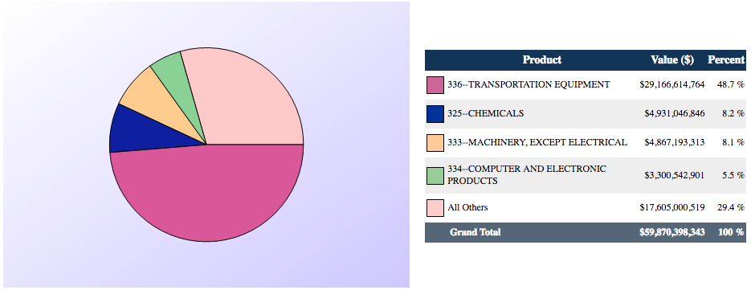
Michigan Exports by Product 2017
Source: International Trade Administration
Notes:
2017 NAICS Total All Merchandise Imports to Michigan from World
ITA http://tse.export.gov/stateimports/ChartDisplay.aspx

Slide 8
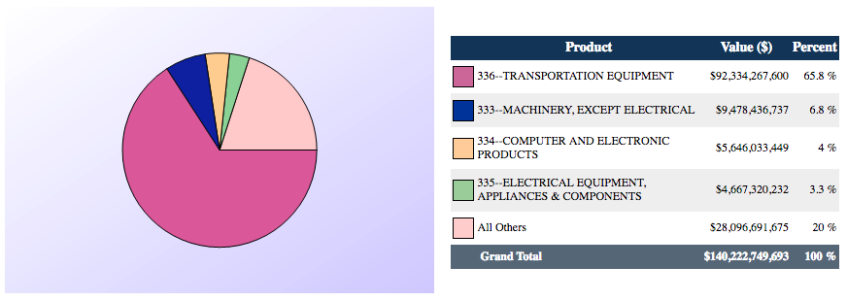
Michigan Imports by Product 2017
Source: International Trade Administration
Notes:
2017 NAICS Total All Merchandise Imports to Michigan from World
ITA http://tse.export.gov/stateimports/ChartDisplay.aspx

Slide 9
Michigan’s Rank among States in 2017 Trade with
North America |  | $ | Per GDP
 | Exports | 3 | 2
 | Imports | 2 | 1
China |  | $ | Per GDP
 | Exports | 9 | 11
 | Imports | 14 | 20
Europe |  | $ | Per GDP
 | Exports | 18 | 22
 | Imports | 13 | 13
Compare: Michigan’s rank by GDP: #14
Source: International Trade Administration

Slide 10
Michigan’s Rank among States in 2017 Trade with
Top 5 Exporters to North America per GDP
North Dakota | 9.8
Michigan | 7.3
Texas | 7.3
Indiana | 5.2
Kentucky | 4.9
North America |  | $ | Per GDP
 | Exports | 3 | 2
 | Imports | 2 | 1
China |  | $ | Per GDP
 | Exports | 9 | 11
 | Imports | 14 | 20
Top 5 Importers from North America per GDP
Michigan | 19.7
Montana | 8.0
Vermont | 7.3
New Hampshire | 7.2
Texas | 6.6
Europe |  | $ | Per GDP
 | Exports | 18 | 22
 | Imports | 13 | 13

Slide 11
Top Michigan Trading Partners 2017
Exports to
Rnk | Country | $bil. | Pct
1 | Canada | 24.9 | 41.6
2 | Mexico | 12.5 | 20.9
3 | China | 3.7 | 6.1
4 | Brazil | 2.3 | 3.8
5 | Germany | 2.0 | 3.3
6 | Japan | 1.6 | 2.6
7 | South Korea | 1.3 | 2.1
8 | Italy | 1.2 | 1.9
9 | U.K. | 0.9 | 1.6
10 | Australia | 0.8 | 1.4
Imports from
Rnk | Country | $bil. | Pct
1 | Mexico | 53.0 | 37.8
2 | Canada | 47.4 | 33.8
3 | China | 9.6 | 6.8
4 | South Korea | 5.3 | 3.8
5 | Germany | 5.1 | 3.6
6 | Italy | 3.8 | 2.7
7 | Japan | 3.3 | 2.4
8 | Spain | 1.4 | 1.0
9 | Taiwan | 1.0 | 0.7
10 | India | 0.9 | 0.7
Source: International Trade Administration

Slide 12
Trump’s 2018 Trade Actions
Most were tariffs on imports
  Levied by US on imports from others
  Levied by others (in retaliation) on US exports
Effects of tariffs
  Raise prices for importers
  Lower prices for exporters
  Cause substitution
    To other products
    To other countries
Net economic effect is almost always negative

Slide 13
Trump’s 2018 Trade Actions
These slides will list only actions actually completed. Most had plans and threats announced in the days and weeks beforehand.

Slide 14
Trump’s 2018 Trade Actions
Jan 22, 2018: Safeguard tariffs
  30% on solar panels
  50% on washing machines

Slide 15
Safeguards
WTO permits tariffs on imports that cause serious injury
Trump used the following:
  30% on solar panels
  50% on washing machines
  (both declining over 3 or 4 years)
Both were on exports of all countries
  Reason: previous China-only tariffs had been evaded by moving production elsewhere

Slide 16
Tariffs on Solar Panels
Why?
  Increased imports from China had driven US companies out
  Anti-dumping duties had failed to help, as companies moved production to other non-China and non-US locations
Notes:
https://www.greentechmedia.com/articles/read/trump-solar-tariffs-manufacturing-renaissance#gs.T145hk31

Slide 17
Tariffs on Solar Panels
Who benefits?
  Who requested
    Suniva, Chinese owned, manufactures in Georgia and in Saginaw, MI
    SolarWorld, was German owned but now French,
  14 US manufacturers, including
    CBS Solar, Copemish, MI
Notes:
https://www.greentechmedia.com/articles/read/trump-solar-tariffs-manufacturing-renaissance#gs.T145hk31

Slide 18
Tariffs on Solar Panels
Who is hurt?
  Solar panel installers, led by Solar Energy Industry Association
  They estimate that the 30% tariff “would cause the loss of 23,000 in 2018, as well as the delay or cancellation of billions of dollars of investments in solar energy.”
Notes:
https://www.brookings.edu/blog/planetpolicy/2018/02/09/what-past-experience-tells-us-about-the-impact-of-new-american-solar-tariffs/

Slide 19
Tariffs on Washing Machines
Why?
  From 2012 to 2016, imports increased dramatically from Korean firms LG and Sumsung
  Anti-dumping duties failed to stop this, as production moved to Thailand and Vietnaa
Notes:
Section 201 Fact Sheet,

Slide 20
Tariffs on Washing Machines
Who benefits?
  Whirlpool, Benton Harbor, MI, which requested the tariffs
    Whirlpool brands include Amana, Maytag,
  Other US manufacturers, such as GE, Electrolux and Frigidaire (Swedish), Equator, Speed Queen
  In 2017, Samsung and LG announced plans to build factories in South Carolina and Tennessee
Notes:
https://www.greentechmedia.com/articles/read/trump-solar-tariffs-manufacturing-renaissance#gs.T145hk31

Slide 21
Tariffs on Washing Machines
Who is hurt?
  Consumers
    US appliance prices (I don’t have washing machines alone) rose 8.1% over the 12 months to Nov 2018
Notes:
https://www.marketwatch.com/story/buying-washing-machines-dishwashers-is-more-expensive-after-trump-tariffs-2018-11-14

Slide 22
Trump’s 2018 Trade Actions
Jan 22, 2018: Safeguard tariffs
Mar 1, 2018: Announces “national-security” tariffs on steel and aluminum
  25% on steel, 10% on aluminum
  Announced for all countries
    Some delayed (EU, Canada Mexico)
    Others later exempted (S. Korea)

Slide 23
National Security
Trump used Section 232 of US trade law to levy tariffs on imports of metals, based on national security
  “Economic security is national security” (Trump Dec 18, 2017)
  25% on steel, 10% on aluminum
  Mar 23: Tariffs start with some exemptions
  Mar 28: Korea exemption permanent in return for a quota cutting its exports to ~80% of 2017
  Jun 1: Tariffs extended to EU, Canada, Mexico

Slide 24
Tariffs on Steel and Aluminum
Responses to metals tariffs
  Retaliation by China, EU, Canada, & others
  WTO disputes
    May-Aug: Complaints filed against US
    Jul: Complaints filed by US

Slide 25
Tariffs on Steel and Aluminum
Who benefits?
  US producers of steel and aluminum
    Steel: AISI lists 12 producers in Michigan
    Aluminum: Thomas lists 76 suppliers in Michigan
Notes:
https://www.thomasnet.com/nsearch.html?cov=MI&heading=1261809&loc=MI

Slide 26
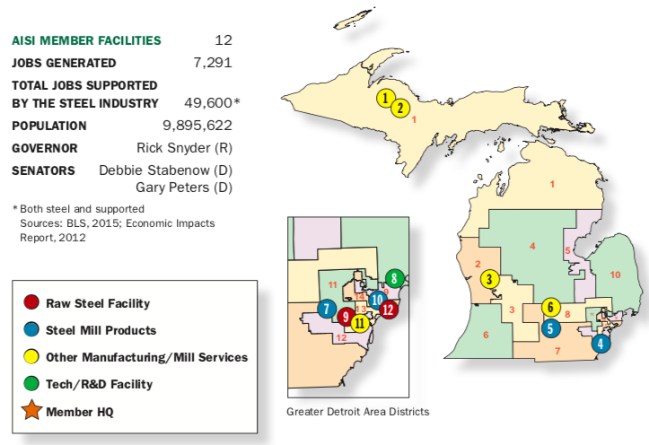
Steel Produced in Michigan
Source: American Iron and Steel Institute
Notes:
https://www.google.com/url?sa=t&rct=j&q=&esrc=s&source=web&cd=1&ved=2ahUKEwi7zrKjoPvfAhUl24MKHbefBHEQFjAAegQICBAC&url=https%3A%2F%2Fwww.steel.org%2F~%2Fmedia%2FFiles%2FAISI%2FPublic%2520Policy%2FMember%2520Map%2F2016%2FMichigan.pdf%3Fla%3Den&usg=AOvVaw2ehYBqEv4U_1Nt6jPckMbi

Slide 27
Tariffs on Steel and Aluminum
Who is hurt?
  US users of steel and aluminum pay higher prices
    Most obviously the car companies but many others

Slide 28
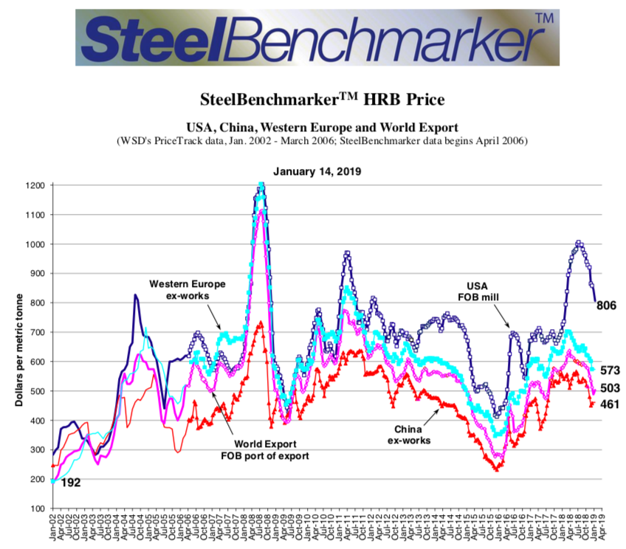
Steel Prices
US 25% Tariff
Notes:
https://www.google.com/url?sa=t&rct=j&q=&esrc=s&source=web&cd=2&ved=2ahUKEwie4caEvILgAhVMyYMKHRMICS4QFjABegQIChAC&url=http%3A%2F%2Fsteelbenchmarker.com%2Ffiles%2Fhistory.pdf&usg=AOvVaw0MbJtconJIfad8p9RPYuA-
BenchMarker, “Price History: Tables and Charts”

Slide 29
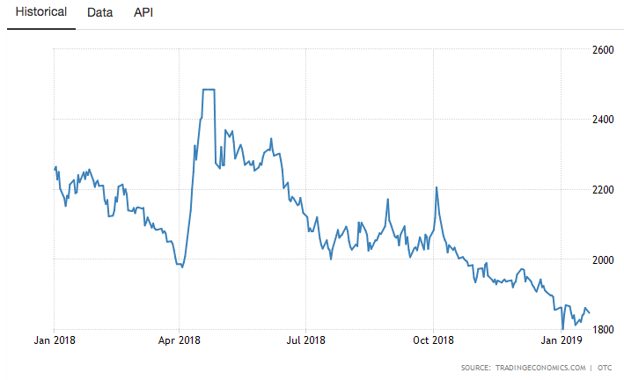
Aluminum Price
US 10% Tariff
Notes:
https://tradingeconomics.com/commodity/aluminum

Slide 30
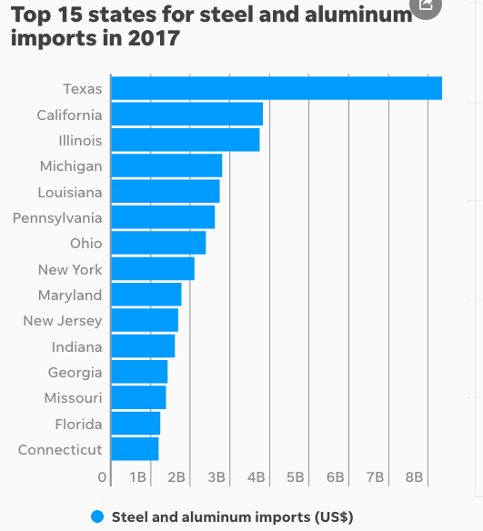
#4
Notes:
https://www.google.com/url?sa=t&rct=j&q=&esrc=s&source=web&cd=2&cad=rja&uact=8&ved=2ahUKEwiXmIfvofvfAhVs7oMKHdviAZAQFjABegQICRAB&url=https%3A%2F%2Fwww.freep.com%2Fstory%2Fmoney%2Fcars%2F2018%2F03%2F08%2Fsteel-aluminum-tarrif-michigan%2F407466002%2F&usg=AOvVaw1idwngjKyJWrBW47w7B9Oq

Slide 31
Trump’s Trade Actions
Jan 22, 2018: Safeguard tariffs
Mar 1, 2018: Announces tariffs on steel and aluminum
May 23, 2018: Initiates Commerce Dept investigation of car and car part imports

Slide 32
National Security
Cars
  Trump initiated another national security investigation: on imported cars
  Trump said he’s considering a 25% tariff on cars and car parts
  This would be bigger than on metals:
    Tariffs on $48 billion of steel and aluminum imports
    Tariffs on $351 billion of car and car part imports
      (per NYT)
Notes:
https://www.nytimes.com/2018/07/19/us/politics/trump-car-import-tariffs.html

Slide 33
Tariff on Cars and Car Parts
Who would benefit?
  US car companies?
    Most (e.g., GM) are opposed
    But I can’t find objection from Ford
  US auto workers?
    UAW has spoken in favor of “target measures” with with understanding that broad tariffs or quotas “could cause harm” including “mass lay-offs for American workers.”
Notes:
https://www.freep.com/story/money/cars/2018/07/19/hearing-auto-import-taxes-get-underway-washington/797915002/
https://www.forbes.com/sites/jimhenry/2018/07/23/with-friends-like-these-auto-import-tariffs-do-not-need-enemies-trade-group-says/#1ebddc9669ab

Slide 34
Tariff on Cars and Car Parts
Who would be hurt?
  Most car companies, including GM
  US car buyers

Slide 35
Tariff on Cars and Car Parts
Estimated Effects on Car Sales and Prices of 25% Tariff
 | Sales impact (units) | Average Price Increases ($/unit) on vehicles sold in US
Tariff on: |  | All | US-assembled | Imported
All imports | –2.0 M | $4,400 | $2,270 | $6,875
Canada & Mexico exempted | –1.2 M | 2,450 | 1,135 | 3,980
Source: Center for Automotive Research
Notes:
https://www.cargroup.org/wp-content/uploads/2018/07/NADA-Consumer-Impact-of-Auto-and-Parts-Tariffs-and-Quotas_July-2018.pdf
Schultz et al., “Trade Briefing: Consumer Impact of Potential U.S. Section 232 Tariffs and Quotas on Imported Automobiles & Automotive Parts,” July 2018

Slide 36
Tariff on Cars and Car Parts
Estimated Effects on Employment & GDP of 25% Tariff
Tariff on: | Total US Employment | US GDP
All imports | –714.7 K | –$59.2 B
Canada & Mexico exempted | –197.2 K | –15.3B
Source: Center for Automotive Research
Notes:
https://www.cargroup.org/wp-content/uploads/2018/07/NADA-Consumer-Impact-of-Auto-and-Parts-Tariffs-and-Quotas_July-2018.pdf
Schultz et al., “Trade Briefing: Consumer Impact of Potential U.S. Section 232 Tariffs and Quotas on Imported Automobiles & Automotive Parts,” July 2018

Slide 37
Tariff on Cars and Car Parts
Estimated Effects on Revenue & Employment in New Car Dealerships of 25% Tariff
Tariff on: | Dealership Revenues |  | Dealership Employment
 | Total | Per D’ship | Total | Per D’ship
All imports | –66.5 B | –4.0 M | –117.5 K | –7
C & M exempted | –39.1 B | –2.3 M | –50.5 K | –4
Source: Center for Automotive Research
Notes:
https://www.cargroup.org/wp-content/uploads/2018/07/NADA-Consumer-Impact-of-Auto-and-Parts-Tariffs-and-Quotas_July-2018.pdf
Schultz et al., “Trade Briefing: Consumer Impact of Potential U.S. Section 232 Tariffs and Quotas on Imported Automobiles & Automotive Parts,” July 2018

Slide 38
Tariff on Cars and Car Parts
Where we stand:
  Commerce Dept. report is due Feb 17
  FT Jan 22: “president was leaning towards slapping tariffs on automotive imports, in the hope of forcing Brussels to further open the EU market to American farm products.”
Notes:
https://www.ft.com/content/a852539e-19d7-11e9-9e64-d150b3105d21

Slide 39
Trump’s Trade Actions
Jan 22, 2018: Safeguard tariffs
Mar 1, 2018: Announces tariffs on steel and aluminum
May 23, 2018: Initiates Commerce Dept investigation of car and car part imports
Jul 6, 2018: First tariffs on China, $34 billion
  On $34 billion of China exports to US
  Based on unfair trade practices in intellectual property (IP)

Slide 40
China
Concerns about China’s IP practices pre-existed Trump
  Theft of technology secrets
  Forcing investors in China into joint ventures and sharing technology
Prior to Trump complaints had been voiced by US and EU, but nothing had been done
US initiated investigation under Section 301 of US trade law (unfair trade practices)
  Aug 18, 2017: Investigation initiated
  Mar 22, 2018: Report finds unfair trade and recommends tariffs
Since then, Trump has announced and then implemented multiple rounds of tariffs

Slide 41
Trump’s Trade Actions
Mar 1, 2018: Announces tariffs on steel and aluminum
May 23, 2018: Initiates Commerce Dept investigation of car and car part imports
Jul 6, 2018: First tariffs on China , $34 billion
Aug 23, 2018: Second tariffs on China, $16 billion
Sep 24, 2018: Third tariffs on China, $200 billion

Slide 42
China
This is a “Trade War”: Tariffs and retaliation
  US tariffs on $34 billion Jul 6 were matched that day by China tariffs on $34 billion of US exports
  US tariffs on $16 billion Aug 23 were matched that day by China tariffs on $16 billion of US exports
  US tariffs on $200 billion Sep 24 were less-than-matched by China on $60 billion of US exports
  Trump has said he’ll use tariffs on still more ($267 billion), approaching all of China’s exports to US

Slide 43
China
What’s the point?
  To get China to stop its IP practices?
  To reduce the US bilateral trade deficit with China?
  To stop China’s rise as an economy and as a world power?
Who will “win”?
  Nobody! Everybody loses from tariffs
  Trump says it’s “easy to win” because he measures success from trade deficit

Slide 44
Tariffs
Source: US Census Bureau (not updated due to Shutdown)

Slide 45
Tariffs
Obama
Trump
Source: US Census Bureau (not updated due to Shutdown)

Slide 46
China
Michigan’s trade with China
  Saw above Michigan’s rank among states:
  As we rank #14 in GDP, Michigan’s exports to China are slightly more than average, imports just average or below.
  Detailed effects depend on products traded and subject to tariffs. Mixed gains and losses, but losses > gains.
  Largest producer effects on cars
China |  | $ | Per GDP
 | Exports | 9 | 11
 | Imports | 14 | 20

Slide 47
Michigan Exports to China by Product 2017
Source: International Trade Administration
Notes:
2017 NAICS Total All Merchandise Imports to Michigan from World
ITA http://tse.export.gov/stateimports/ChartDisplay.aspx

Slide 48
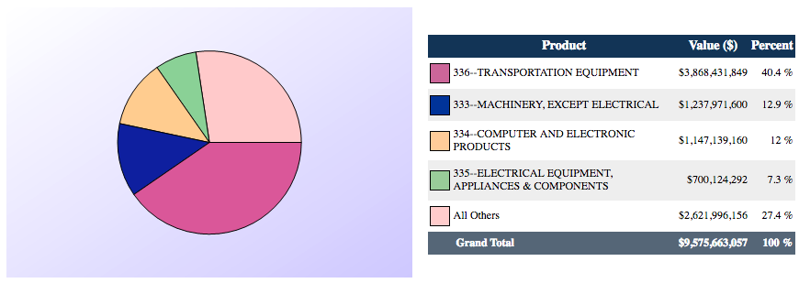
Michigan Imports from China by Product 2017
Source: International Trade Administration
Notes:
2017 NAICS Total All Merchandise Imports to Michigan from World
ITA http://tse.export.gov/stateimports/ChartDisplay.aspx

Slide 49
China
Michigan’s trade with China in cars and car parts
  Imports
    Cars almost none: ∴No effect of US tariffs
      China sold only 3 of every 10,000 cars in US in 2017 (0.03%)
    Parts, a lot:
      Car companies hurt
      Some parts companies benefit

Slide 50
China
Michigan’s trade with China in cars and car parts
  Exports
    China raised tariff from 25% to 40% in trade war
    China bought over 250,000 US-made cars in 2017, in spite of 25% tariff (but <1% of market)
    Exports are luxury cars, not sensitive to price
  China
    Raised tariff on US cars from 25% to 40% in response to trade war
    Now promises (has already?) reduced tariff to 15%
Notes:
https://www.politifact.com/truth-o-meter/statements/2018/apr/09/donald-trump/donald-trump-right-china-slaps-25-percent-tariff-a/

Slide 51
Makers of top-20 US-made models sold in China in 2017
 | Models | Cars
Ford/Lincoln | 5 | 44,487
BMW | 4 | 106,971
Mercedes-Benz | 4 | 72,187
Jeep | 3 | 15,831
Tesla | 2 | 14,779
Toyota | 1 | 7,460
Chevrolet | 1 | 977
Source: USA Today from LMC Automotive
Notes:
Bomey, Nathan,"20 American-made cars that could benefit from China's promise to roll back tariffs," USA TODAY, April 10, 2018
https://www.usatoday.com/story/money/cars/2018/04/10/chinese-auto-tariffs-xi-jinping/503470002/

Slide 52
States producing top-20 US-made models sold in China in 2017
 | Models | Cars
South Carolina (BMW) | 4 | 106,971
Alabama (Mercedes) | 4 | 72,187
Michigan (Jeep, Chevy, Ford, Lincoln) | 4 | 21,873
Kentucky (Lincoln) | 2 | 19,517
California (Tesla) | 2 | 14,779
Illinois (Ford; Jeep) | 2 | 14,603
Indiana (Toyota) | 1 | 7,460
Ohio (Jeep) | 1 | 5,302
Source: USA Today from LMC Automotive + Wikipedia
Notes:
https://en.wikipedia.org/wiki/List_of_automobiles_manufactured_in_the_United_States#BMW_Group_[12]

Slide 53
China
Bottom line for Michigan
  Trade war with China does not appear to hurt Michigan any more than most states
  Michigan’s exports to China won’t respond much to China’s tariffs
    (Compare to soybean exporters, who compete with Brazil)
  Michigan’s imports from China are mostly similar to other states’
    Some can be bought from other countries

Slide 54
Trump’s Trade Actions
Jul 6, 2018: First tariffs on China , $34 billion
Aug 23, 2018: Second tariffs on China, $16 billion
Sep 24, 2018: Third tariffs on China, $200 billion
Sep 24, 2018: Amended KORUS signed
  Raises Korea quota for US-certified cars
  Extends years of US 25% tariff on light trucks

Slide 55
Korea
Increased quota for US cars that
    Meet US standards
    Do not meet Korean standards
  Quota doubles from 25,000 to 50,000 cars per auto maker
  In fact, US companies have not usually reached the 25,000 limit

Slide 56
Korea
Original KORUS had US promise to remove its 25% ”chicken tax” on light trucks from Korea by 2019.
This is now extended to 2041
This seems important for US makers of pickup trucks, including in Michigan

Slide 57
Trump’s Trade Actions
Aug 23, 2018: Second tariffs on China, $16 billion
Sep 24, 2018: Third tariffs on China, $200 billion
Sep 24, 2018: Amended KORUS signed
Sep 30, 2018: USMCA agreed
  NAFTA renegotiation had completed previously with Mexico
  Now Canada signed on, and name changed (by Trump) to USMCA
  USMCA: U.S.-Mexico-Canada Trade Agreement

Slide 58
NAFTA → USMCA
NAFTA is
  Free Trade Agreement (FTA)
    Zero tariffs on goods traded by US, Canada, Mexico
    Only if they satisfy Rules of Origin (ROOs)
  Additional provisions regarding many things
    Services trade
    Foreign direct investment
    Intellectual property rights
    Dispute settlement
    Government procurement

Slide 59
NAFTA → USMCA
USMCA will be (if approved)
  FTA with stricter ROOs
  Some changes in NAFTA’s additional provisions
  New rules for environment, labor, financial services, digital trade
  Weakening of Canada’s dairy barriers
  Discouragement of trade with China
  Provision for renegotiation (sunset)

Slide 60
NAFTA → USMCA
Most important for Michigan: Tighter ROOs for cars and car parts
  North American content increased from 62.5% to 75%
    Intended to reduce inputs from outside N. America, likely benefiting Mexico
  New requirement that 40-45% of content must be from labor paid $16/hr or more (but does not rise with inflation)
    Intended to reduce inputs from low-wage Mexico, benefiting US and Canada

Slide 61
NAFTA → USMCA
Effects of tighter ROOs
  If ROOs are
    Satisfied: Higher costs of production
    Not satisfied: Tariffs on traded inputs and final products
  Either way
    Prices rise
    Demand falls
    Products become less competitive internationally
  Effects on demands for labor ambiguous throughout

Slide 62
NAFTA → USMCA
Will USMCA be ratified?
  Needs ratification in all three countries
  In US, there are problems
    Democrats want changes
      Stronger enforcement of labor provisions
      Remove tariffs on steel and aluminum
    Approval requires a report from USITC, which is currently closed due to shutdown
  Trump threatens to issue six-month withdrawal notice from NAFTA
Notes:
https://www.ft.com/content/6f1b275a-1b43-11e9-9e64-d150b3105d21

Slide 63
Conclusion
Trump’s trade actions in 2018
  In all states, but especially Michigan
    Raise prices to consumers
    Raise costs to producers
  Alienate other countries
May they serve any purpose?
  Not to reduce trade deficit(s)
  Perhaps to motivate other countries to change policies for the better

